Slide 1


JavaScript Fundamentals: Course Introduction
JS Course Program, Evaluation, Exams, Resources
Telerik Software Academy
Learning & Development Team
http://academy.telerik.com

Slide 2

Table of Contents
What's Coming Next in the Academy?
The JavaScript Course Program
Exams and Evaluation
Standard Criteria
Bonuses
Resources for the Course

Slide 3

JavaScript Fundamentals
Coming To The Next Module

Slide 4

What's Coming Next?
JavaScript Fundamentals
Continuation of CSS Styling and OOP
Fundamentals of JavaScript
Pretty much the same
Lectures 3 times a week
Practical exam after a month
The course exam?
3-4 problems for 6 hours
http://bgcoder.com

Slide 5

JavaScript Fundamentals – Program
What Will We Cover in the JavaScript Course?

Slide 6


JavaScript Fundamentals - Course Program
JavaScript Fundamentals Course Intro
Course Program, Exams, Evaluation
Introduction to JavaScript development
Dynamic HTML (DHTML), JavaScript history, JavaScript usage, JavaScript syntax, helper objects (console, document), Tools

Slide 7


JavaScript Fundamentals - Course Program (2)
Data types and variables -
Data types, numeric types, strings, dates
Operators and Expressions
Bitwise operators, logical operators, boolean operators, expressions
Conditional statements
if and if-else statements
switch-case statements

Slide 8
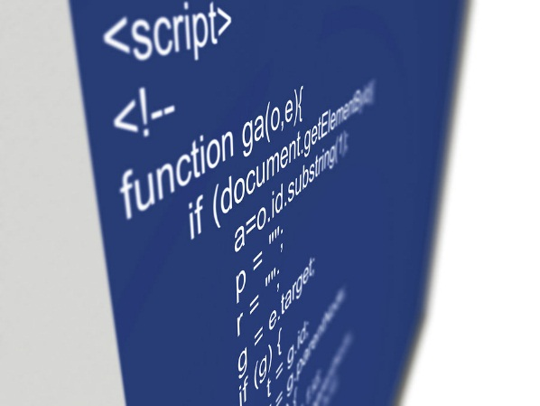
JavaScript Fundamentals - Course Program (3)
Loops
Loops in JavaScript, for loop, while loop, do-while loop, for-in loop
Arrays
Arrays, Array object, Array constructor, one-dimensional arrays, multi-dimensional arrays
Manipulation of Arrays
Add, remove
Splice, clear, sort, etc…

Slide 9


JavaScript Fundamentals - Course Program (4)
Functions
Functions in JavaScript, with/without parameters
arguments function object
Using objects
Creating objects, using objects, JSON objects
Associative arrays
Strings
Manipulation of strings
String methods

Slide 10
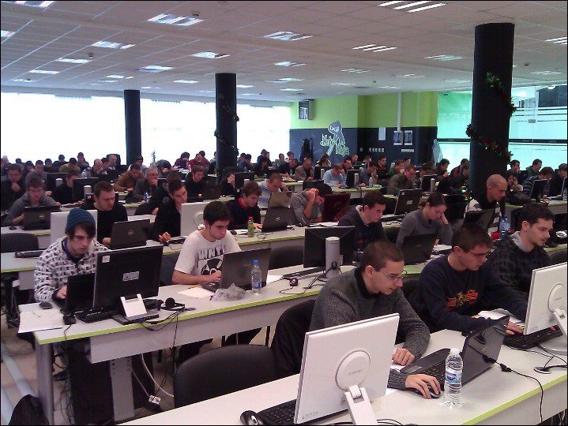

JavaScript Fundamentals - Course Program (5)
Exam preparation
Solving problems with JavaScript
Practical Exam

Slide 11





Evaluation
Thank God There Are Bonuses!

Slide 12

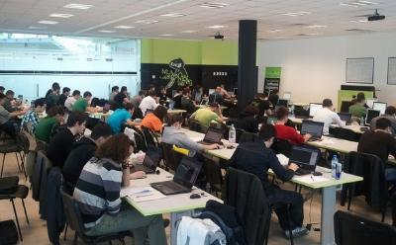
JavaScript – Evaluation
Evaluation components
Practical exam – 65%
Homework – 15%
Homework evaluation – 10%
3 peer reviews per homework
Attendance in class – 10%
Bonuses
Forums activity – bonus up to 5%

Slide 13








Resources
What We Need in Addition to this Course Content?

Slide 14
JavaScript Resources
Mozilla Development Network (MDN)
https://developer.mozilla.org
Mostly used for the presentations
Web Platform
http://www.webplatform.org
The place where all masters contribute
Adobe, Apple, Facebook, Google, HP, Intel, Microsoft, Mozilla, Nokia, Opera, W3C

Slide 15
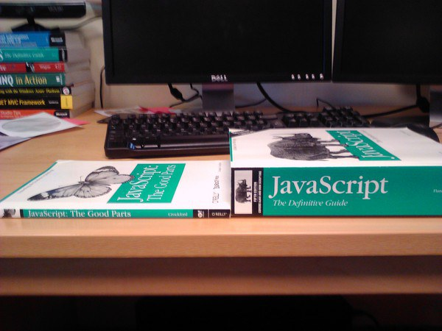
Books

Slide 16
Course Web Site & Forums
Register for the "Telerik Academy Forums":
Discuss the course exercises with your colleagues
Find solutions for the exercises
Share source code / discuss ideas
The JavaScript Fundamentals official web site:
http://forums.academy.telerik.com/front-end-development/javascript-part-1
academy.telerik.com/student-courses/ programming/object-oriented-programming/about

Slide 17
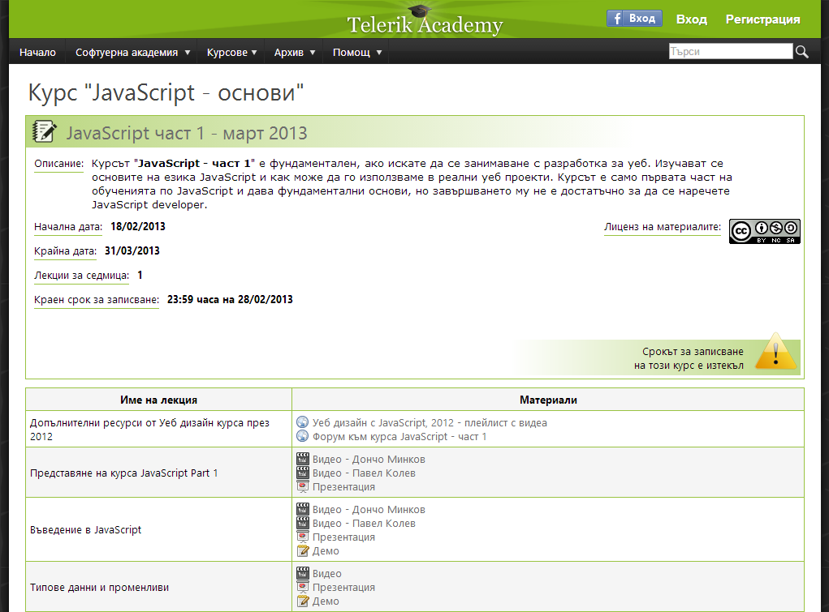
Telerik Integrated Learning System (TILS)
The Telerik Integrated Learning System (TILS)
www.telerikacademy.com
Important resource for all students
Homework submissions
Homework peer reviews
Presence cards with barcode
Reports about your results
telerikacademy.com/Courses/Courses/Details/173

Slide 18



Required Software
Software needed for this course:
Microsoft Visual Studio 2013 or Visual Studio Express 2013 (free version of VS 2013)
Sublime Text
Komodo IDE
Notepad ++

Slide 19



JavaScript Fundamentals Introduction
http://academy.telerik.com

Slide 20



Free Trainings @ Telerik Academy
Web Design and UI Technologies @ Telerik Academy
html5course.telerik.com
Telerik Software Academy
academy.telerik.com
Telerik Academy @ Facebook
facebook.com/TelerikAcademy
Telerik Software Academy Forums
forums.academy.telerik.com

